Slide 1
Lecture 17
Analog Circuit Test --
A/D and D/A Converters
Motivation
Present state-of-the-art
Advantages of DSP-based analog tester
Components of DSP-based analog tester
Static A/D converter test
Static D/A converter test
Summary

Slide 2
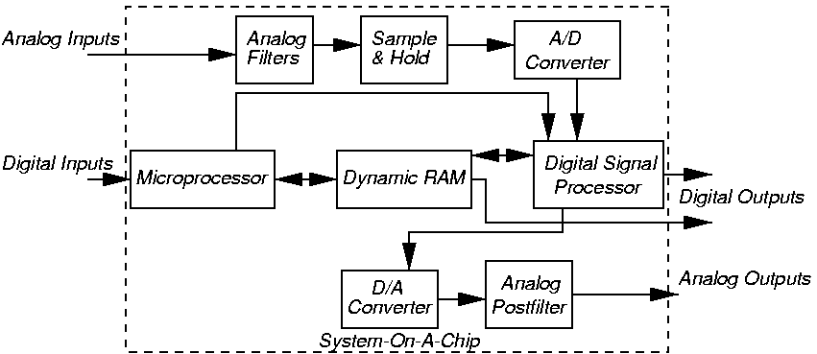
Mixed-Signal Testing Problem

Slide 3
Motivation
Mixed-signal (analog + digital) ICs more common
  Wireless, networking, multi-media, real-time control – explosive growth
  Digital core (Digital Signal Processor (DSP) and μprocessor) surrounded by A/Ds, filters, D/As, MEMs devices
  Less distance between transducer and measurement point – less noise
More linear, less non-linear analog circuitry
  Move non-linear function into DSP unit
  Easier to test
  Analog MOS devices run in transistor saturation mode
Mixed-signal has testing observability problem

Slide 4
Differences from Digital Testing
Size not a problem – at most 100 components
Much harder analog device modeling
  No widely-accepted analog fault model
  Infinite signal range
  Tolerances depend on process and measurement error
  Tester (ATE) introduces measurement error
  Digital / analog substrate coupling noise
  Absolute component tolerances +/- 20%, relative +/- 0.1%
    Multiple analog fault model mandatory
  No unique signal flow direction

Slide 5
Decomposability and Test Busses
Analog sub-components cannot be individually tested as in digital circuits
Test busses harder to realize for analog test
  Transporting analog signal to output pin alters signal and circuit function
  Reconfiguring analog circuit often unacceptable – changes analog transfer function
  Bus not designed to test frequency response -- only tests that a specific R, L, or C has the expected value

Slide 6
Present-Day Analog Testing Methods
Specification-based (functional) tests
  Main method for analog – tractable and does not need an analog fault model
  Intractable for digital -- # tests is huge
Structural ATPG – used for digital, just beginning to be used for analog (exists)
Separate test for functionality and timing not possible in analog circuit
  Possible in digital circuit

Slide 7
DSP-Based Tester Benefits over Analog Tester
More accurate
Reduces crosstalk, noise, signal drift
Less non-linearity
Component aging less troublesome
Thermal effects less troublesome
Faster when making multiple measurements
Eliminates filter settling time of analog Automatic Test Equipment (ATE)
More repeatable testing
Easier calibration
More measurement information provided
Smaller, cheaper, and uses less power

Slide 8
Definitions
ADC – A/D converter
ATE – Automatic Test Equipment
DAC – D/A converter
DFT – Discrete Fourier Transform
DUT – Device-Under-Test
FFT – Fast Fourier Transform
Glitch Area -- area in DAC output of glitching pulses
Jitter – Low-level electrical noise – corrupts LSB’s, especially prevalent on converter clocking circuits
ks/s – Kilo-samples/sec

Slide 9
More Definitions
LSB -- Least Significant Bit (of converter)
Measurement – Result of measuring O/P analog parameter and quantifying it
Measurement Error – Introduced by measurement process
Non-Deterministic Device – All analog circuit measurements are not repeatable due to DUT or tester measurement noise
Phase-Locked-Loop – Clock circuit with feedback to keep desired signal phase
Settling Time -- Time for DAC reconstruction filter to settle
Test – Combination of analog stimulus, measurement of voltage or current, with a measurement error tolerance

Slide 10
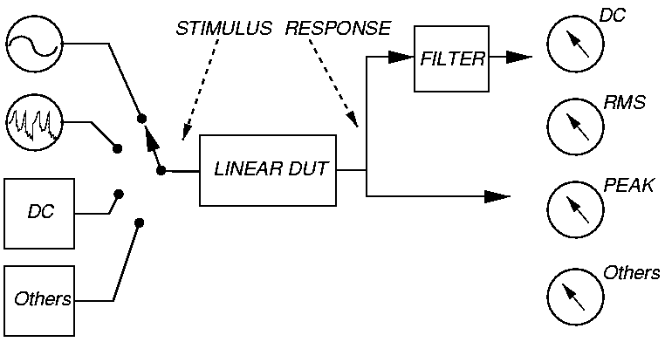
Analog Tester Concept
© 1987 IEEE

Slide 11
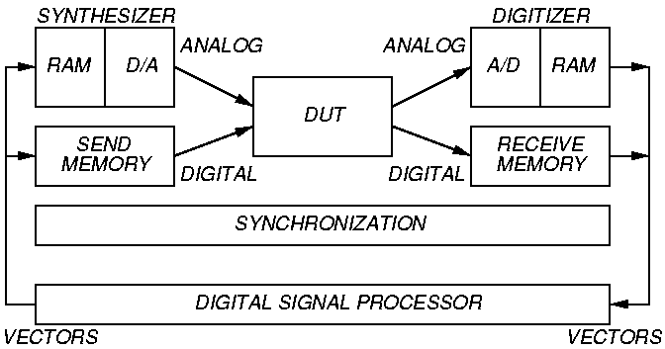
DSP Tester Concept
© 1987 IEEE

Slide 12
DSP Tester Characteristics
  Very fast DSP array processor
  Needs 31 bits precision – double-precision
  N = number of samples
  Signal / quantization noise of entire vector
N times better than that of 1 sample

Slide 13
DSP Tester Mechanism
  Requires phase-lock synchronization between stimulus and sampling
Component of 1 kHz
Amplitude Measurement
Relay Switching
Load & Start Synthesizer
Synthesizer + DUT Settling
Filter + Detector + DUT Settling
Digitization Interval
Transfer Time
Computer Overhead
DSP Processing/Overhead
Total
DSP
ATE
5 ms
5 ms
1 ms
N/A
1 ms
1 ms
N/A
15 ms
28 ms
Analog
ATE
5 ms
N/A
N/A
35 ms
N/A
N/A
10 ms
N/A
50 ms

Slide 14
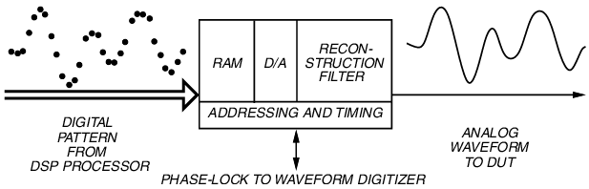
Waveform Synthesis
© 1987 IEEE
  Needs sin x / x (sinc) correction – Finite sample width

Slide 15
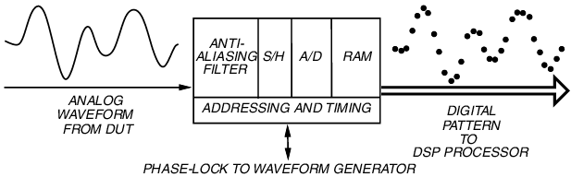
Waveform Sampling
© 1987 IEEE
Sampling rate > 100 ks/s

Slide 16
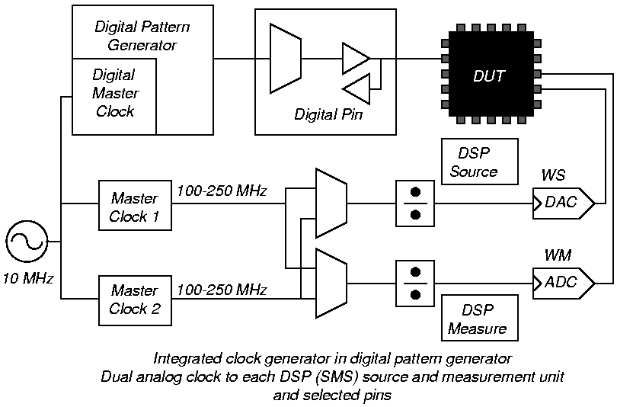
ATE Clock Generator
WS = waveform source WM = waveform measurement

Slide 17
Cadence Test Programming Language
1
2
frequency
period
times
over
set master clock to <double> <int>
connect dp master clock
to pm line <word1>
clock ws main mem with pm clock <word1>
divide by <word2>
set wm to pm clk <word1> divide by <word2>
internal reference
doubled reference
source1
source2

Slide 18
A/D and D/A Converter Static Testing Methods

Slide 19
A/D and D/A Test Parameters
A/D -- Uncertain map from input domain voltages into digital value (not so in D/A)
  Two converters are NOT inverses
Transmission parameters affect multi-tone tests
  Gain, signal-to-distortion ratio, intermodulation distortion, noise power ratio, differential phase shift, envelop delay distortion
Intrinsic parameters – Converter specifications
  Full scale range (FSR), gain, # bits, static linearity (differential and integral), maximum clock rate, code format, settling time (D/A), glitch area (D/A)

Slide 20
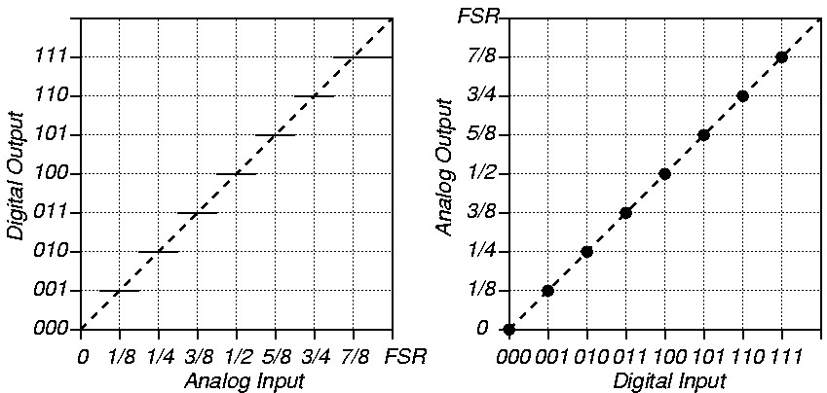
Ideal Transfer Functions
A/D Converter
D/A Converter

Slide 21
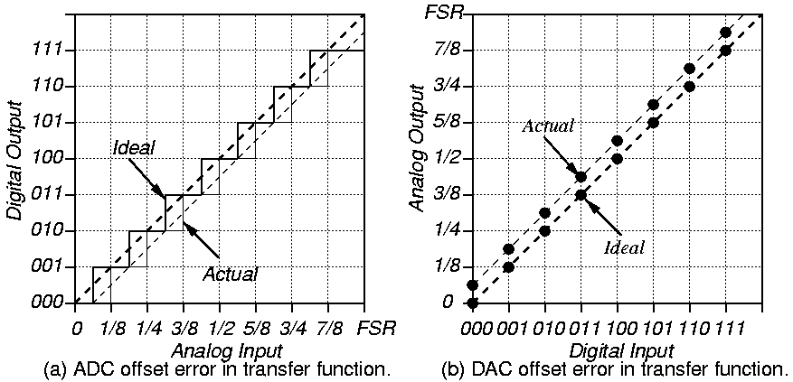
Offset Error

Slide 22
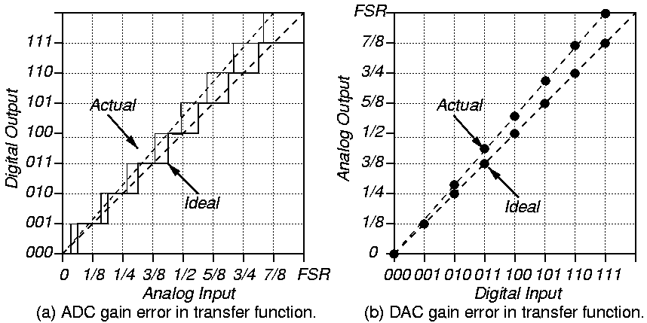
Gain Error

Slide 23
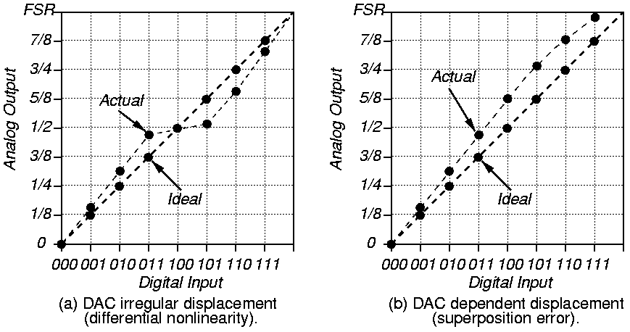
D/A Transfer Function Non-Linearity Error

Slide 24
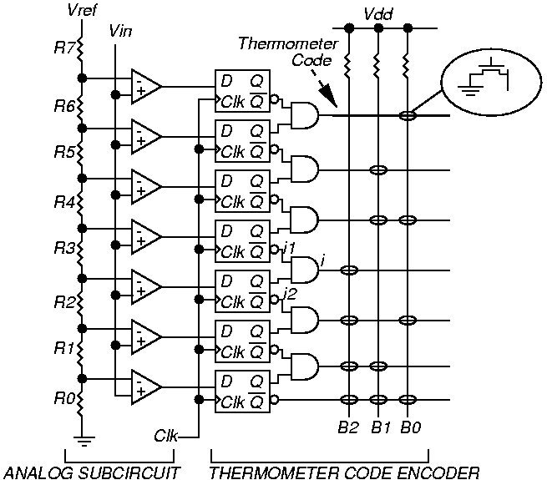
Flash A/D Converter

Slide 25
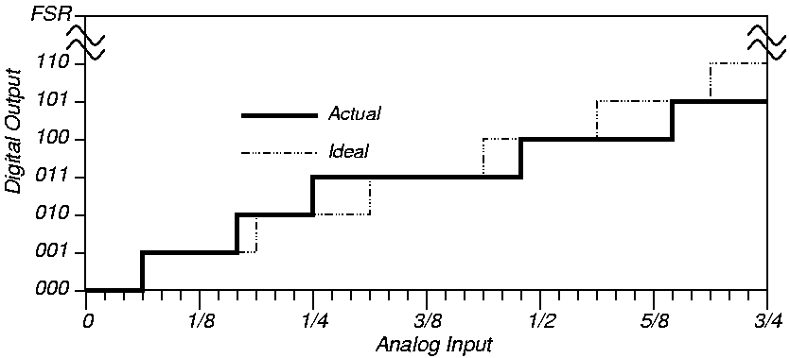
Static Linearity Test

Slide 26
Static Linear Histogram
DNL and INL in RMS LSB
Code Count
DLE (LSB
fraction)
DNL
Transfer
Char.
(counts)
ILE (LSB
fraction)
INL
T (0)
3 + 3 = 6
D (0)
-0.1176
C (0)
0
E (0)
0
T (1)
5
D (1)
-0.265
C (1)
5.5
E (1)
-0.191
T (2)
4
D (2)
-0.412
C (2)
10
E (2)
-0.529
T (3)
11
D (3)
0.618
C (3)
17.5
E (3)
-0.427
T (4)
8
D (4)
0.177
C (4)
27
E (4)
-0.030
0.3650
0.3161

Slide 27
Differential Linearity Error
    Differential linearity function – How each code step differs from ideal or average step (by code number), as fraction of LSB
    Subtract average count for each code tally, express that in units of LSBs
    Repeat test waveform 100 to 150 times, use slow triangle wave to increase resolution

Slide 28
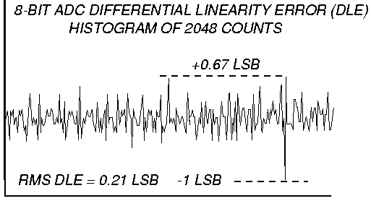
Example DLE Function
© 1987 IEEE
DLE
Code

Slide 29
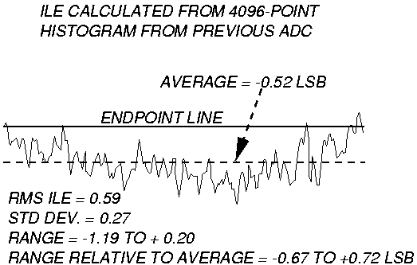
Integral Linearity Error (ILE)
© 1987 IEEE
DLE [i] + DLE [i – 1]
2
ILE [i] = ILE [i – 1] x

Slide 30
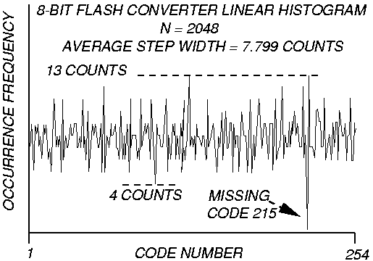
Linear Histogram and DLE of 8-bit ADC
© 1987 IEEE

Slide 31
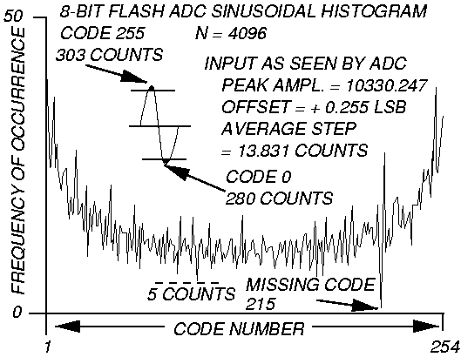
Sinusoidal Histogram
© 1987 IEEE
Catches sparkle and glitch codes
N (# samples)
2 – 4 x
that for
linear
histogram

Slide 32
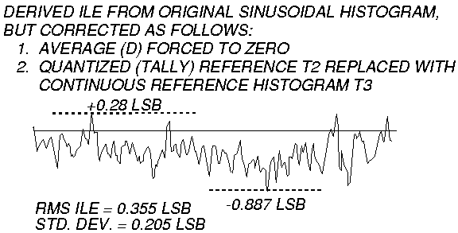
Sinusoidal DLE
© 1987 IEEE

Slide 33
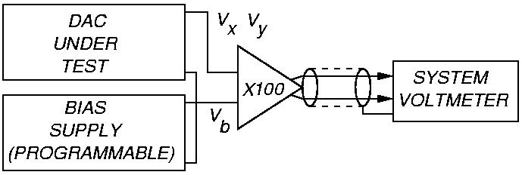
D/A Differential Test Fixture
© 1987 IEEE
Measure V_{y} – V_{x} difference, not absolute V_{x} or V_{y}

Slide 34
Summary
DSP-based tester has:
  Waveform Generator
  Waveform Digitizer
  High frequency clock with dividers for synchronization
A/D and D/A Test Parameters
  Transmission
  Intrinsic
A/D and D/A Faults: offset, gain, non-linearity errors
  Measured by DLE, ILE, DNL, and INL
A/D Test Histograms – static linear and sinusoidal
D/A Test –- Differential Test Fixture

